Slide 1
Watermarking

Slide 2
Introduction
The watermark is becoming more and more important in our daily life.
When we transfer the image from one device to another device, some place in the image will change. So we use watermaking to recover image.

Slide 3
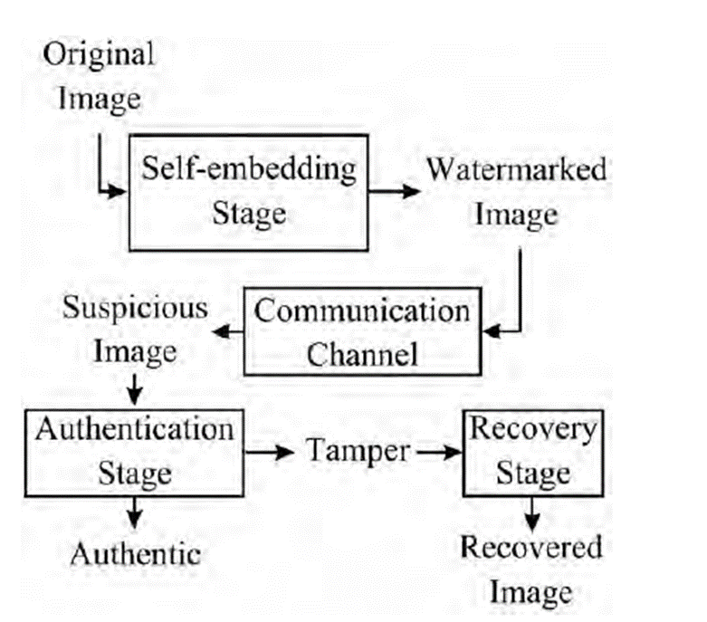
General Idea

Slide 4
Watermarking-based image authentication with recovery capability using the block-basedhalf-toning technique (2011)
Luis Rosales-Roldan a, ManuelCedillo-Hernandez b, MarikoNakano-Miyatake a,n,
Hector Perez-Meana a, BrianKurkoski c

Slide 5
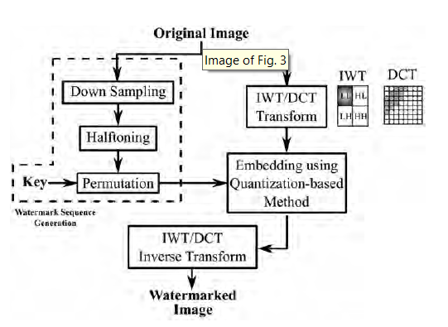
Embedding Stage

Slide 6
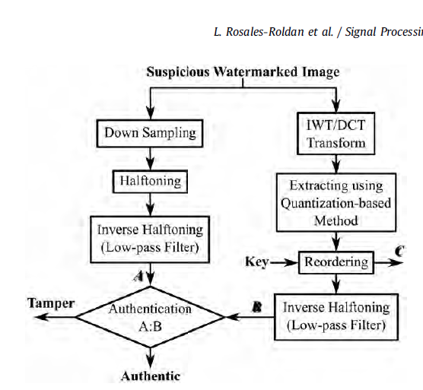
Authentication Stage

Slide 7
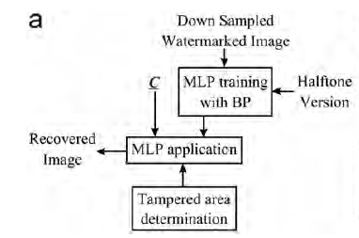
Recovery Process

Slide 8
An efficient watermarking technique for tamper detection and localization of medical images (2018)
Solihah Gull · Nazir A. Loan · Shabir A. Parah · Javaid A. Sheikh · G. M. Bhat

Slide 9
Secure and Robust Fragile Watermarking Scheme for Medical Images (2018)
ABDULAZIZ SHEHAB, MOHAMED ELHOSENY, KHAN MUHAMMAD ,
ARUN KUMAR SANGAIAH, PO YANG, HAOJUN HUANG, AND GUOLIN HOU

Slide 10
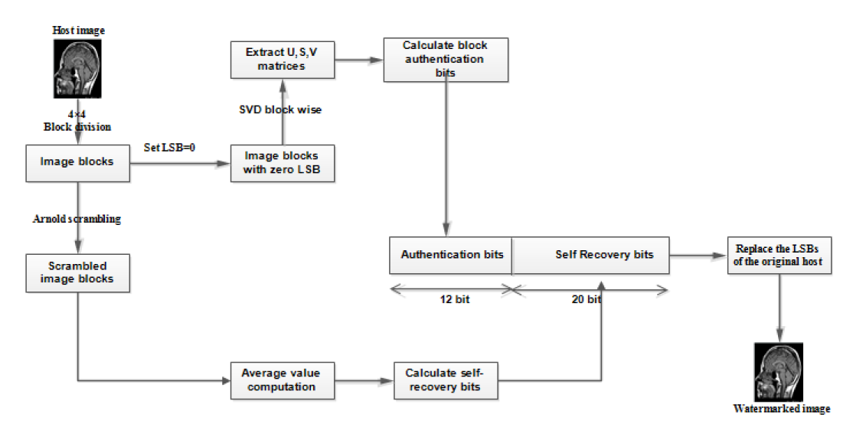
Embedding Process

Slide 11
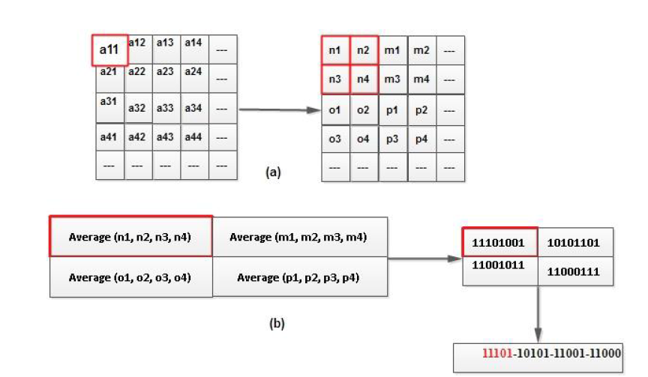
The Idea of Getting Recovery bits

Slide 12
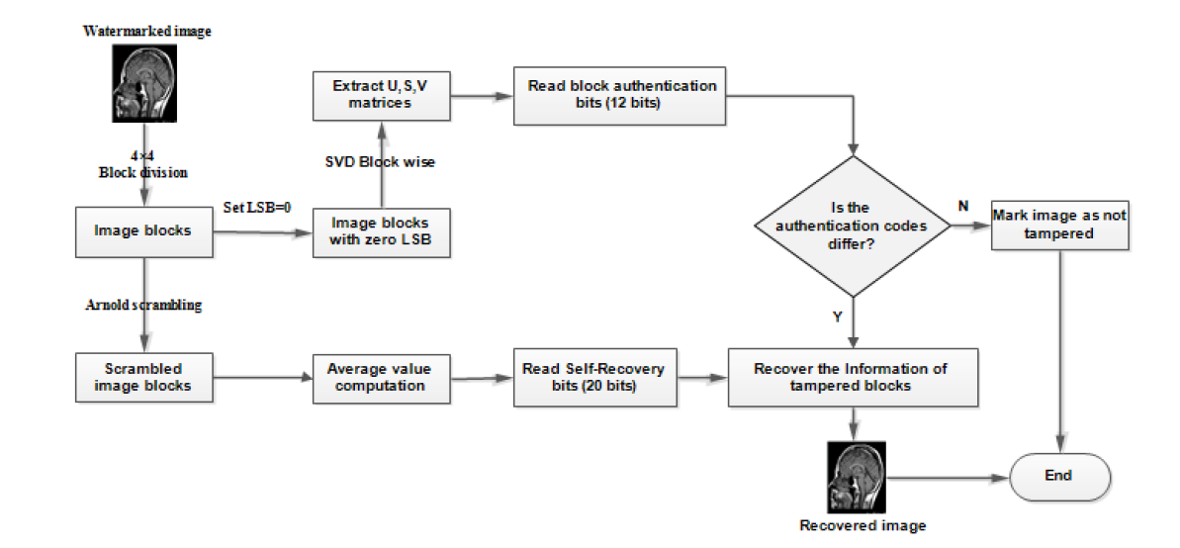
Authentication and Recovery Process

Slide 13
Image tamper detection and self-recovery using multiple median watermarking (2019)
Vishal Rajput1 & Irshad Ahmad Ansari1

Slide 14
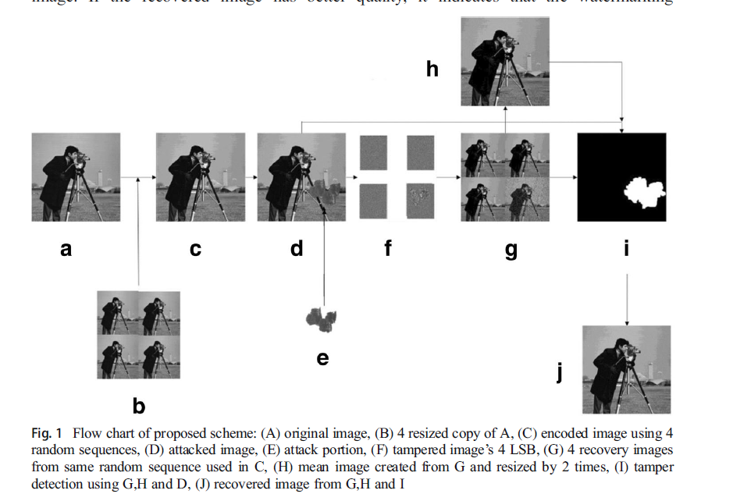
Flow chart

Slide 15
Self-Embedding Authentication Watermarking with Effective Tampered Location Detection and High-Quality Image Recovery (2019)
Chin-Feng Lee 1 , Jau-Ji Shen 2, Zhao-Ru Chen 2 and Somya Agrawal

Slide 16
Two detection methods
Block-wise detection
Pixel-wise detection

Slide 17
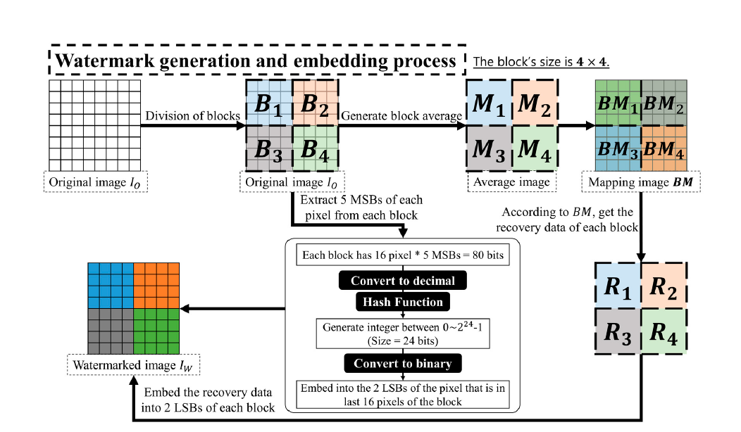
Watermark Generation(block-wise)

Slide 18
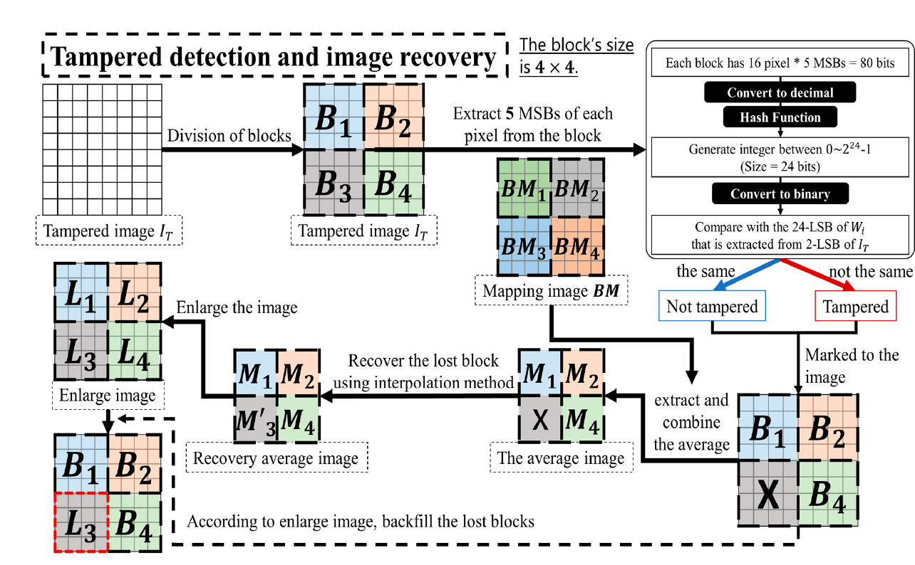
Tamper Detection and Recovery(block-wise)

Slide 19
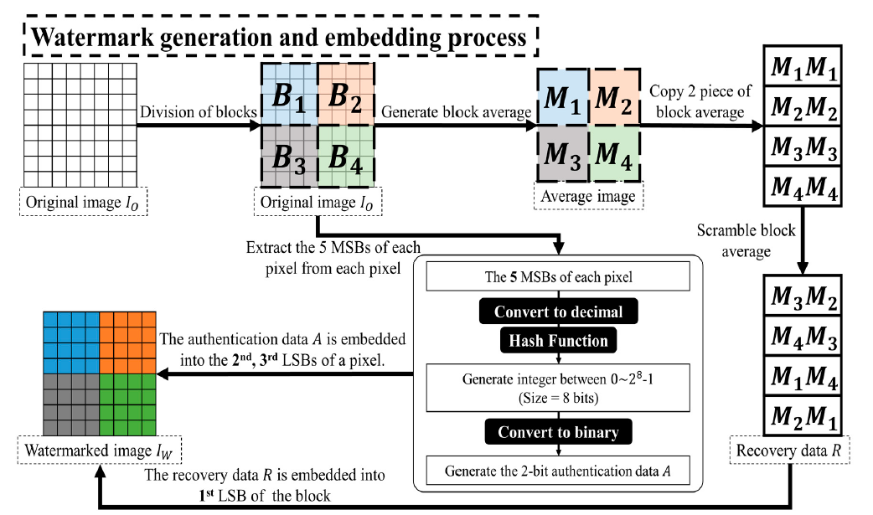
Watermark Generation(pixel-wise)

Slide 20
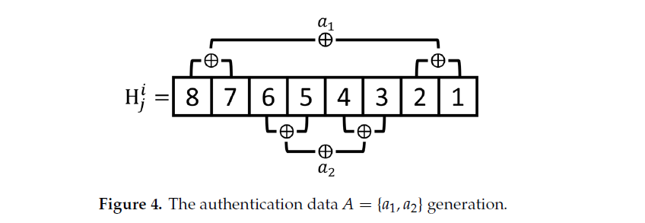
Authentication Data Generation

Slide 21
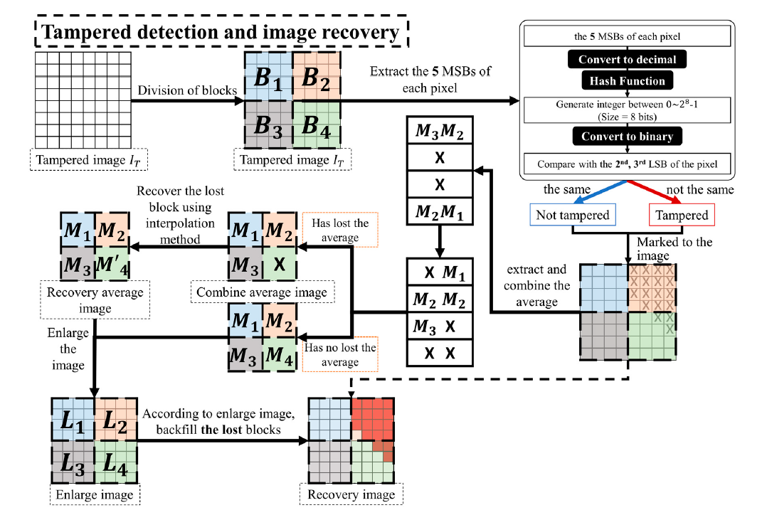
Tamper Detection and Recovery(pixel-wise)

